Slide 1

THE MAHARAJA SAYAJIRAO UNIVERSITY OF BARODA
FACULTY OF SCIENCE
DEPARTMENT OF STATISTICS
STATISTICAL TECHNIQUES
By :
Karan Parmar
Mausami Khunt
Dhara Bholani
Shreya Mathur
Vishwa Kavishwar
Paresh Chaudhari
Kushal Kumar Kain

Slide 2
TOPICS
MEASURE OF CENTRAL TENDENCY
SAMPLING
CORRELATION
REGRESSION
SQL

Slide 3
MEASURE OF CENTRAL TENDENCY
- It indicates the location or the general position of the distribution on X-axis.
- Types of measure of central tendency:
                MEAN
                MEDIAN
                MODE

Slide 4
MEAN
What is mean?
  - Arithmetic average of a set of given number.
Types :
  - Arithmetic mean : Total sum of all values divided by the total number of values.
  - Geometric mean : nth root of product of all numbers.
  - Harmonic mean : It is the reciprocal of arithmetic mean of the reciprocal of values.

Slide 5
MEDIAN
- It is the middle score in a set of given numbers.
MODE
The most frequently occurring number in a set of given numbers.
RELATION : 3median = mode + 2mean

Slide 6
SAMPLING
The action or process of taking samples from population data.
Type of sampling :
            Probability sampling
            - Simple random sampling
            - Stratified random sampling
            - Systematic random sampling
            - Cluster sampling
            Non probability sampling
            - Convenience sampling
            - Snowball sampling

Slide 7
ALLOCATION METHODS
What will be the size of our samples?
- Types of allocation of sample size:
          Equal allocation
          Proportional allocation
          Neyman allocation
- Equal allocation:
          Number of units will be equal in all strata.
- Proportional allocation:
          Each strata will be different in size.
- Neyman allocation/Optimal allocation:
          Size of strata and variability in strata both are different.

Slide 8
CORRELATION
- Extent of relationship
- Measure the strength and direction
- Measure scale
- Disadvantage
- Example

Slide 9
REGRESSION
- A process which identify the mathematical relationship between a dependent variable and one or more independent variables.
- This relationship is used for prediction purpose.
- Types of regression:
        Linear regression
        Non-Linear regression

Slide 10
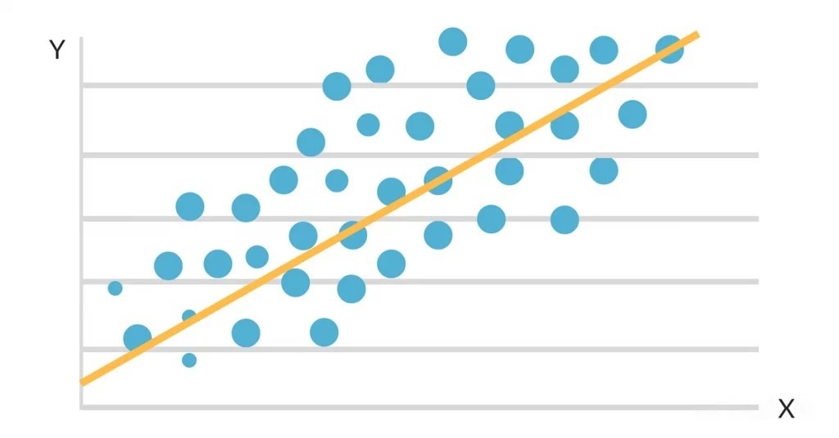
SCATTER PLOT

Slide 11
MODEL
- General linear model of the regression will be looking like:
y = a + bx + e
where, y = dependent variable, x = independent variable/ explanatory variable,
        a = intercept, b = slop of the line, e = random error/ residual
- Assumptions:
- linearity: there has to be a linear relationship between x and y.
- independence: if there are more than one independent variables in the model then all the x's must be mutually independent.
- homoscedasticity: residual(e) variance are constant over the x.
- normality: residual(e) are iid normal distributed with zero mean and constant variance.
- Any one of the above assumption are violating in any situation this model will not good enough for the prediction.

Slide 12
LOGISTIC REGRESSION
When the response variable is binary in nature.
Example :
- predicting email is spam or not
- predicting the likelihood that an individual experiences a heart attack

Slide 13
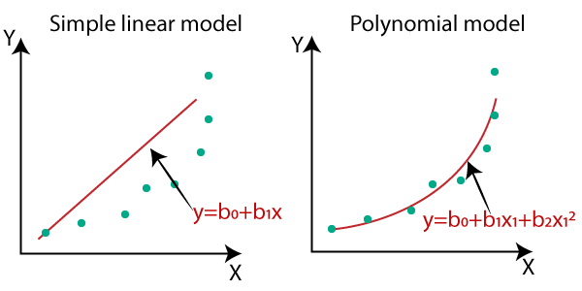
POLYNOMIAL REGRESSION
When relationship between predictor variable and the response variable is non-linear.

Slide 14
RIDGE REGRESSION
When the predictor variables are highly correlated.
Example :
- To predict the salary of the basketball player from points and assists.
POISSON REGRESSION
When the response variable consists of count data.
Example :
- To predict the number of awards earn by the student from the program in which the student was enrolled and score on his\her final exam.

Slide 15
SQL
  - Why and What is SQL?
      SQL stands for Structured Query Language
      Used for communicating with database with English-like statement queries.
      Used to query database for insights and modifications when required
      Uses mainly 4 types of SQL languages, DDL, DML, DCL, TCL
      The application used to perform such tasks is called Database Management System and few popular ones are MySQL, PostgreSQL, Oracle, Microsoft Access, MongoDB.

Slide 16
How to work with SQL?
    Either working in the terminal or query tool of the application.
    Selection of correct data model.
    Defining proper relations/schemas of the entities and their characteristics.
    Proper assignment of different keys.
    Clear view of the objectives to accomplish.

Slide 17
Putting together everything
    Most basic query statements.
    Managing different tables within same or different databases
    Aggregate functions
    Relational algebra
    Join functions

Slide 18
THANK YOU!

